Slide 1
Clean Code: Easy to read, understand

Slide 2
Planning: 8 weeks
Easy-to-read and understand code
Clean functions
OOP
SOLID
Data structures and objects
Design Rules
Code Smells
Testing and error handling

Slide 3
What is clean code?
Code, which is easy to:
Read
Understand
Maintain

Slide 4
Why clean code? Common situation
-“Hey, could you look at my code?”
-”Sure, what’s up?”
-”Line 9802 in file Core.cs returns wrong value”
-“Oh, what’s in the line?”
-“var l = GetData(kj.Where(a => a.jas == “si”).FirstOrDefault()); // data” -“...”

Slide 5
Why clean code? Answer
Only 10 % of our time is spent writing code
90 % of the time is spent reading the code
The dirtier the code is, the more time it takes to:
Remember what we wrote
Find what and where went wrong
Other person to get into the project
To understand the purpose of code
Clean code gives good long term results, improves productivity!

Slide 6
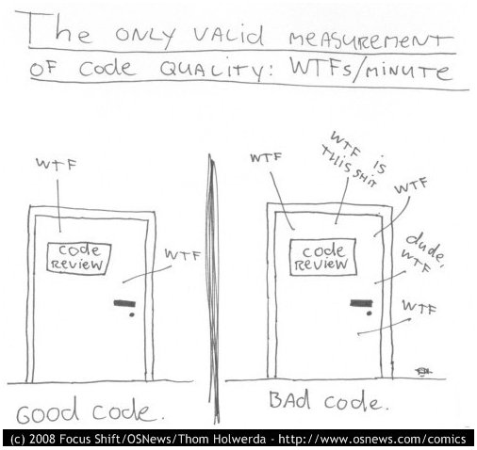
Measure of good code
WTFs/minute :)

Slide 7
Naming
“Naming Things is the hardest of things that programmers have to do”

Slide 8
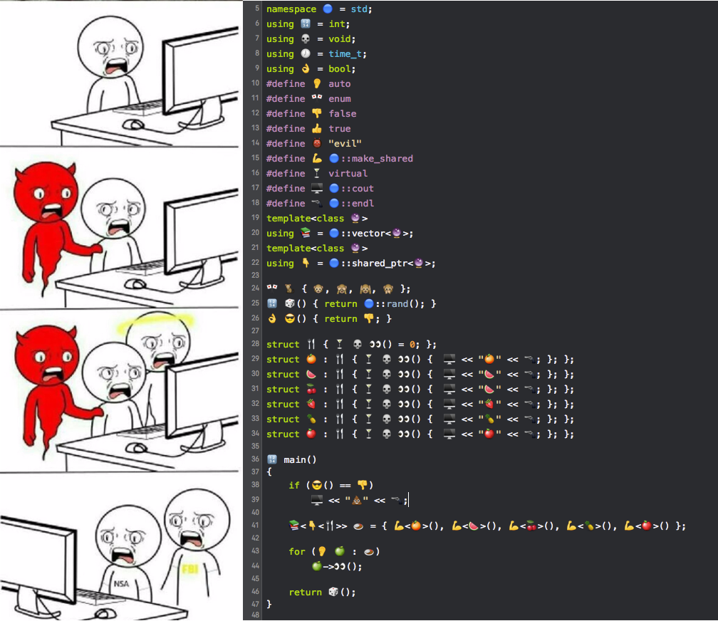
The problem
Sometimes our code looks like this:
With names that only we can understand
With functions that need our consultation in order to understand

Slide 9



Basic rules
Good Bad
Unambiguous
Prefer NOT to use types at the end
Contain minimal info, meaningful
English
Easy to pronounce
Consistent (even if bad)
Conventional (unless arbitrary)
Do not use keywords

Slide 10

Type
Good Bad
Specify it explicitly, when:
Hard to tell what type it is
Type needs to be emphasised
It’s a team convention
In all other cases use var, because:
It provides no extra info
It’s faster to write
Sometimes don’t have to care about the type

Slide 11
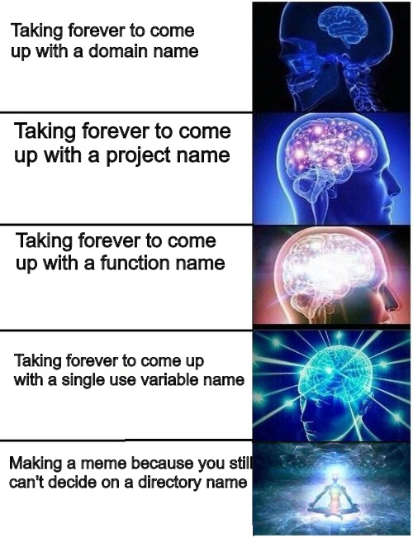
Spend plenty of time but..
When you write code, stop for a few moments and consider a good name
Don’t spend more time on naming than on writing code in general

Slide 12
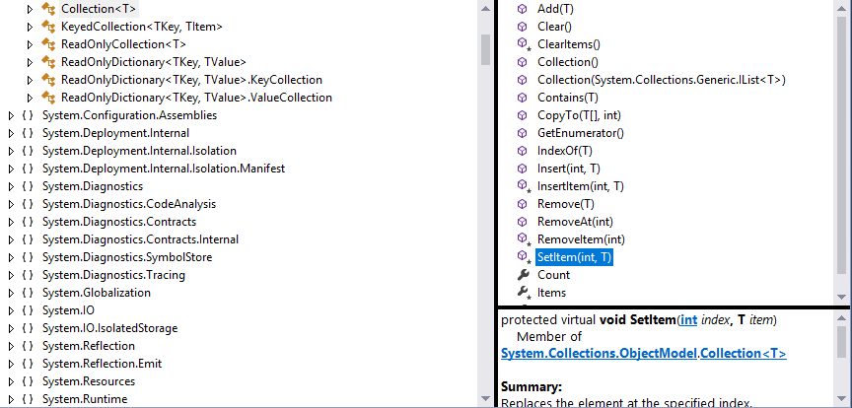

The Best Guideline: Main Framework
The framework that you use is the best source of great naming

Slide 13
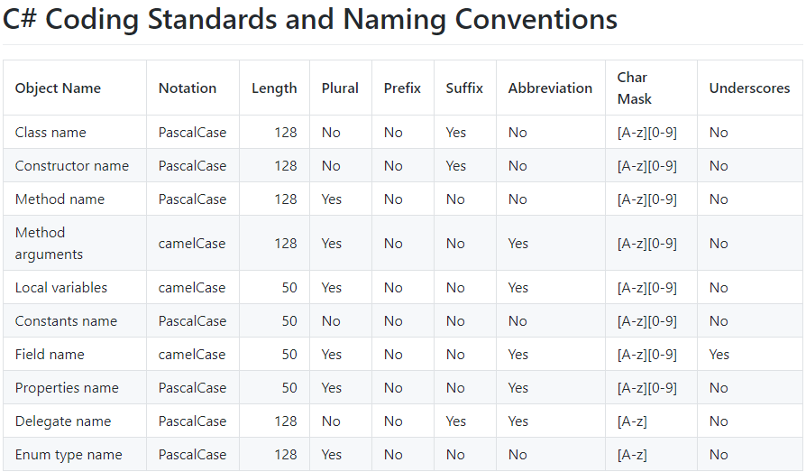
Community source
Official MS docs

Slide 14
Comments
“A comment quickly becomes inaccuracy, a gossip, which in time transforms into a lie”

Slide 15
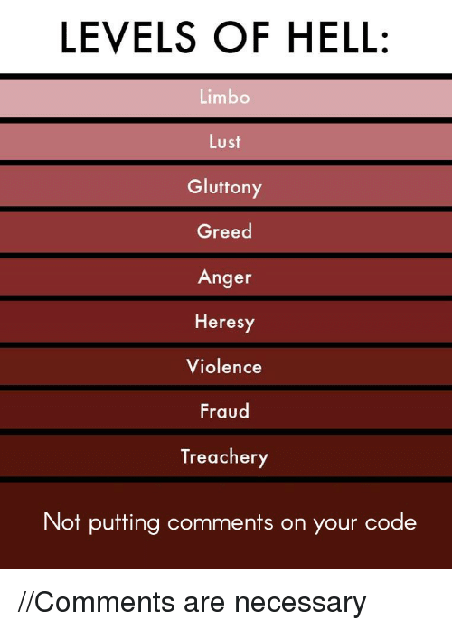


Why you DO NOT need them?
Code speaks for itself
Good name is better than a good comment
Comment disrupts readability
Don’t :)

Slide 16
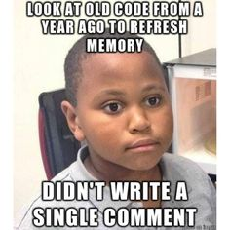
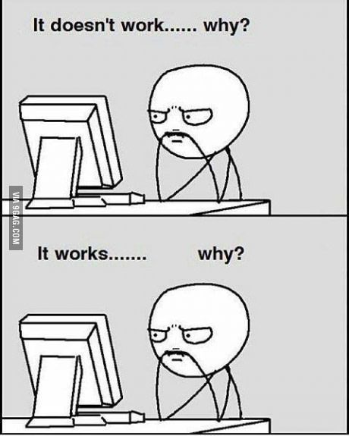
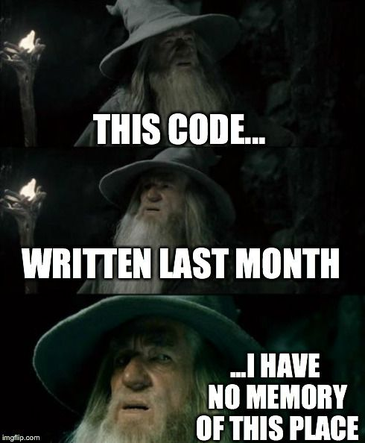
Why you need them?
Learning purposes
Explaining consequences
Clarifying what was not expressive enough with code

Slide 17
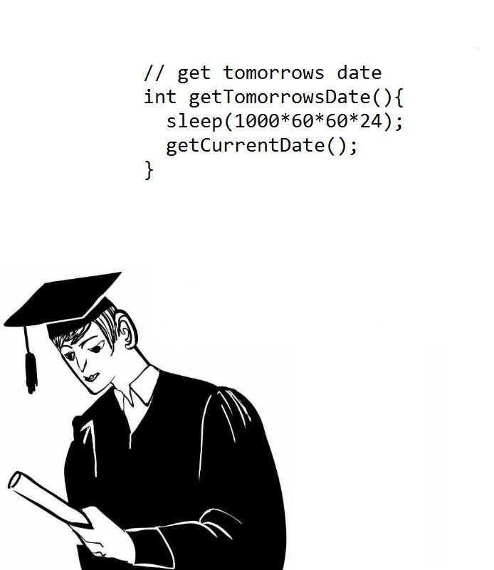
So think twice, before writing it
Writing a comment in most cases should feel like a defeat, because a programmer failed to express himself/herself with code.

Slide 18
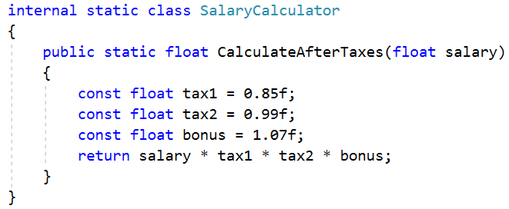
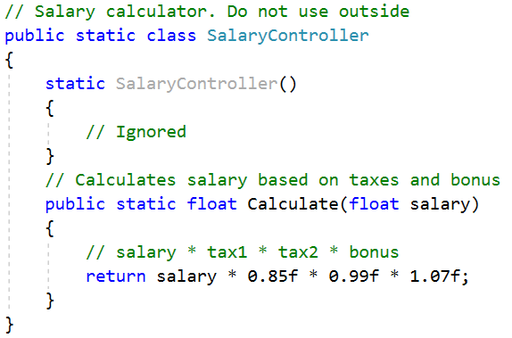
Tips
Good Bad
Don’t write a comment for the obvious
Used named constants instead of a comment
If consider writing a comment, consider:
Renaming
Restructuring

Slide 19
Code Structure
“Writing code is much like writing a book. You start with words, make sentences. Sentences go into paragraphs which in time morph into makes chapters.”

Slide 20
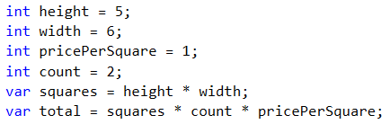
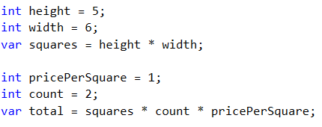
Keep related code close
Bad
Declare variables close to their usage
Related code should be vertically dense
Better

Slide 21


Keep it short, indented with intention
Keep lines short.
Don't break indentation
Use white space to associate related things and disassociate weakly related.
Not so good
Good
Bad
Better

